Slide 1
What in the World is Industrial Hygiene?
by
AIHA Student and Early Career Professionals Committee

Slide 2


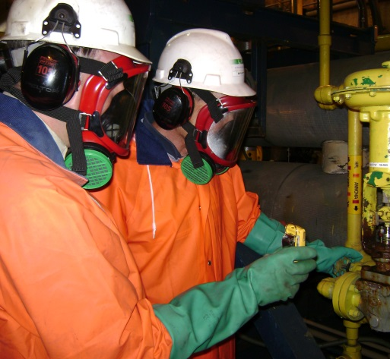

Industrial Hygienist
IHs wear many different hats
Sometimes as a:
  Scientist
  Investigator
  Trainer/Educator
  Technician
  Policy enforcer
  Engineer
  Emergency Responder
  and more!

Slide 3
IH Defined
Industrial hygiene is the science of protecting and enhancing the health and safety of people at work and in their communities.
Health and safety hazards cover a wide range of chemical, physical, biological and ergonomic stressors.
Those dedicated to anticipating, recognizing, evaluating and controlling those hazards are known as industrial hygienists.

Slide 4
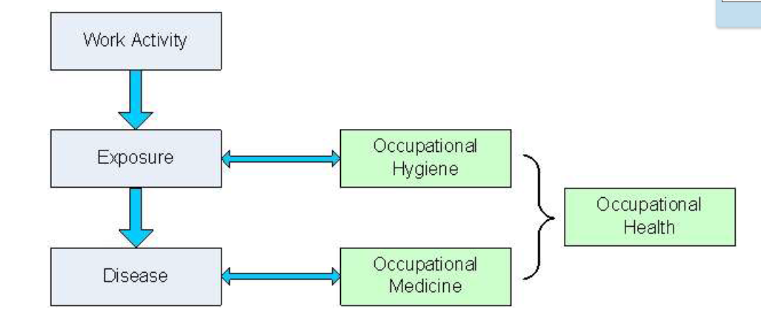
Industrial Hygiene/Occupational Health
-EH&S (Environmental, Health & Safety)

Slide 5
Anticipation
Involves identifying potential hazards in the workplace before they are introduced.
Example
  A funeral home employee (embalmer) works with embalming fluids that contain a carcinogen known as formaldehyde.
  Is the employee being protected while working?
    What is in the fluid, how does the employee use it, where is it being used and how often?

Slide 6

Recognition
Involves identifying the potential hazard that a chemical, physical or biological agent - or an adverse ergonomic situation - poses to health.
Example
  The IH researches the chemicals (in this case formaldehyde) to understand the hazards and performs an assessment to determine how the employee(s) will be/are using it.
    Interviews, inspects, reviews medical surveillance programs, health and epidemiology studies, worker health complaints, occupationally-related compensation claims, and industrial hygiene monitoring information.

Slide 7
Anticipate & Recognize Review
Anticipate or recognize things such as:
  Chemical agents: gases, vapors, solids, fibers, liquids, dusts, mists, fumes, etc.
  Physical agents: noise and vibration, heat and cold, electromagnetic fields, lighting etc.
  Biological agents: bacteria , fungi, etc.
  Ergonomic factors: lifting, stretching, and repetitive motion
  Psychosocial factors: stress, workload and work organization
Once anticipated or recognized, the hazard can then be evaluated and eventually controlled to eliminate or reduce the impact of the hazard.

Slide 8
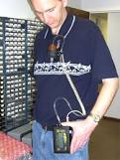

Evaluation
Evaluate the extent of the exposure.
This often involves measuring the personal exposure of a worker to the hazard/agent in the workplace and understanding what PPE they currently use.
Compare to SDS recommendations including occupational exposure limits, where such criteria exist.
Example
  Depending on the use, the IH may
  collect personal breathing air samples
  to determine his/her exposure to help
  select the most appropriate PPE for
  inhalation. Absorption and ingestion
  potential will also be reviewed.

Slide 9
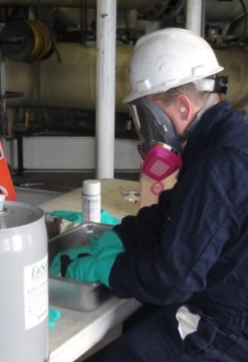
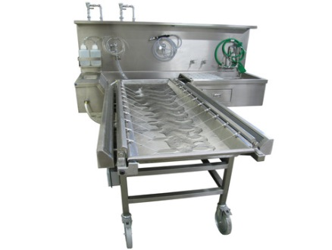

Control
Control by procedural, engineering or other means where the evaluation indicates that this is necessary.
Example
  If results show the chemical is hazardous, the best idea is to find a less hazardous replacement or engineer a solution (e.g. ventilation). If not, adding administrative controls or adding PPE may be necessary.
    Embalmers previously used arsenic.
      They’ve replaced it with less hazardous (but still hazardous) formaldehyde
    Ventilation may be added to control fumes
    PPE such as gloves are used

Slide 10
Job Diversity
Industrial hygienists are not limited to one particular type of industry; they are employed in a variety of organizations such as:
  Chemical companies
  Colleges and universities
  Government
  Insurance companies
  Manufacturing companies
  Public utilities
  Research laboratories
  Consulting firms
  Hospitals
  Hazardous waste companies

Slide 11
Salary
The following figures are based on the 2013 AIHA Salary Survey.
As of June 30, 2013, the average mean salary for all respondents was $105,166, 25 percent of the respondents earned $80,000 or less, and 25 percent earned $124,239 or more.
The median was $100,000.

Slide 12
Questions?
To learn more, please visit the AIHA website: https://www.aiha.org/
Education
  Bachelor’s degree in engineering, chemistry, physics, or in a closely related biological or physical science major.
  Twenty-two universities currently offer ABET accredited industrial hygiene master’s level programs.
  Four universities offer ABET Accreditation of bachelor-level industrial hygiene programs.
  https://www.aiha.org/about-ih/IHcareers/

Slide 13

The Right Thing to Do: What is IH? -video (7.5 min)
https://www.youtube.com/watch?v=0k7GPWBoCa0 (produced by AIHA)

Slide 14
Perform Exercise
Ideas
  Noise – sound level meter
  Oxygen monitor
  CO2 monitor (indoor vs. outdoor)
  Velocity meter and fan
  Light meter
  Breathing zone air sample equipment demo
  Colorimetric tubes & Bellows pumps

